Slide 1

Project on
HAND GESTURE CONTROLLED TELEVISION SYSTEM USING COMPUTER VISION

Slide 2
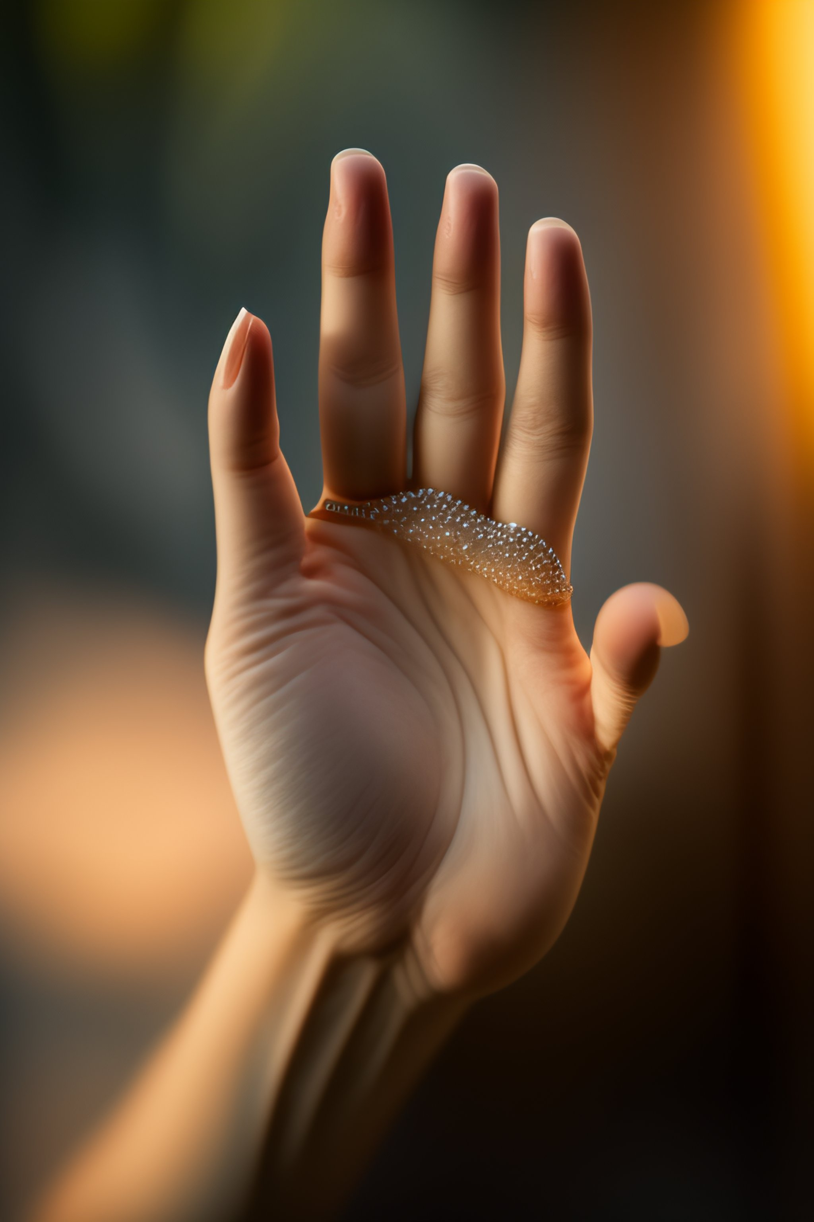
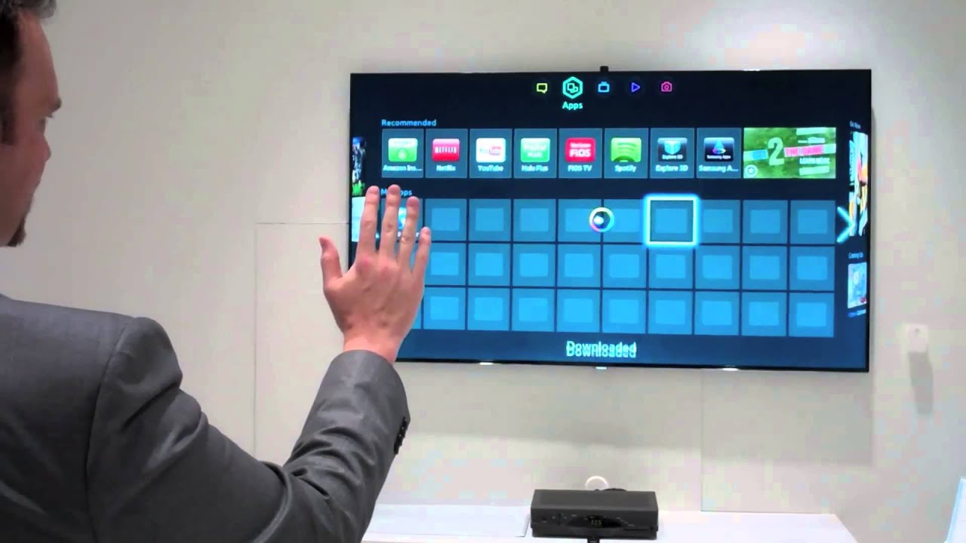
Steps for designing the system
Step 1 : Capture Video
The first step is to capture the video from a camera using Video Capture class of OpenCV.
Step 2 : Pre-Processing of Video
The second step is to pre-process the video frames to reduce noise and enhance the contrast using OpenCV function like : Gaussian blur and Threshholding.
Step 3 : Detecting the hand region
The hand region can be detected and isolated from the rest of the image using the following techniques like : Shape detection and Background subtraction.

Slide 3
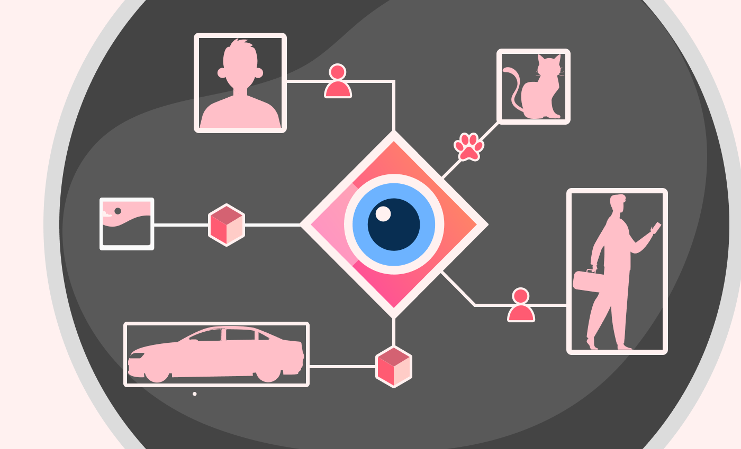
Step 4 : Extracting the features
Once the hand region is detected various features such as Contour , Convex hull and deflects can be extracted from it.
These features can then be used to recognize different hand gestures.
Step 5 : Classifying Hand gesture
Finally the extracted feature can then be used to classify the hand gesture using the following machine learning algorithms:
K Nearest Neighbour (KNN)
Support Vector Machine (SVM)
Step 6 : Performing the Task
Based on the detected gesture a control signal will be generated to perform & execute the various operation/action of the television system that are assigned to that gesture.

Slide 4

Diagramatic representation
Input video from Camera
Pre-Processing of Image
Feature extraction
Frame Capture
Hand Segmentation
Generation of control signal for performing action on TV based on gesture
Classification and prediction using ML Algorithms
Matched Image
Pre-Stored gesture
THANK YOU

